Slide 1


Ohio University
WebAssign with eBook
Ohio University Inclusive Access program
Notes:
INSERT LOGO FROM THE SIDE TO FIT THIS TO YOUR PLATFORM.

Slide 2
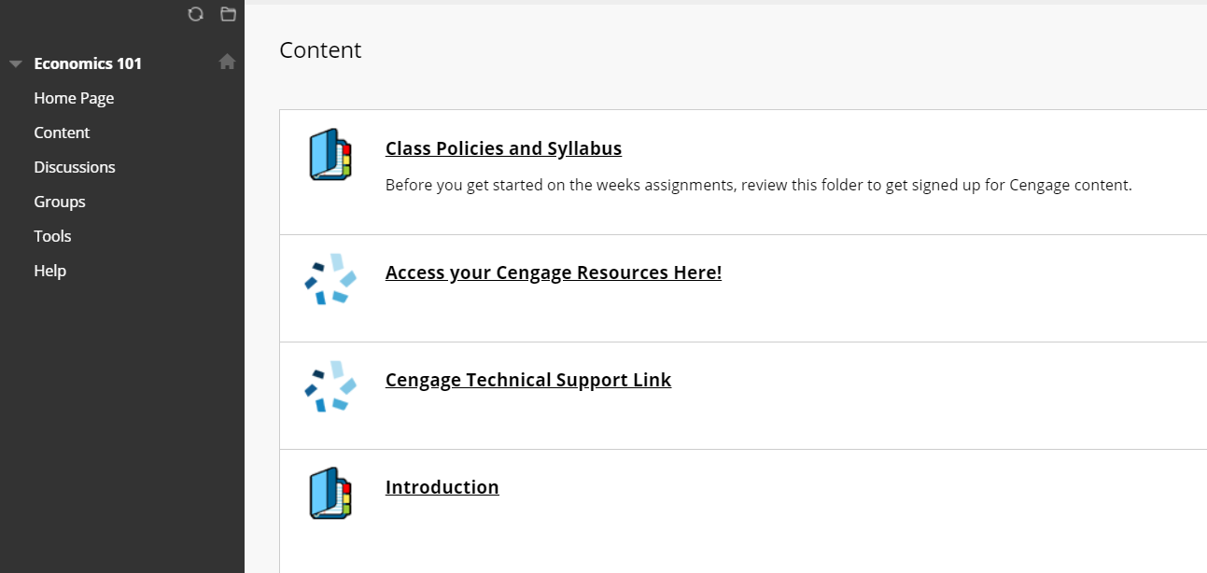
Click on the WebAssign Link in Your Blackboard Course
Go to your OU Blackboard account and log in.
Navigate to your course.
Click any link to WebAssign content to continue the registration process.
  If you aren't sure where to click, ask your instructor.
Your course materials will open in a new tab or window, so be sure pop-ups are enabled. Chrome or Firefox are the preferred web browsers
You’ll know you’ve clicked the right one when you see the Cengage login screen.

Slide 3
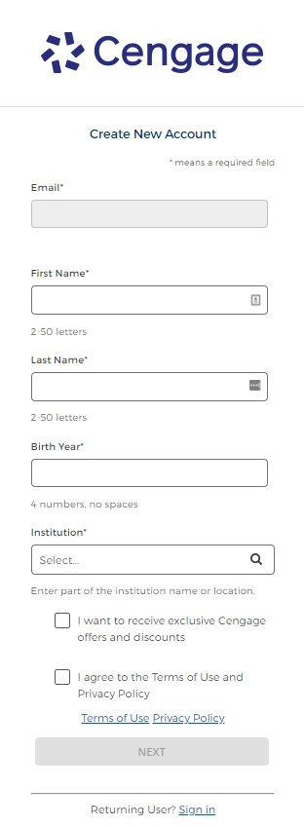
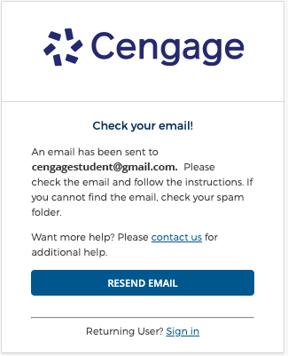
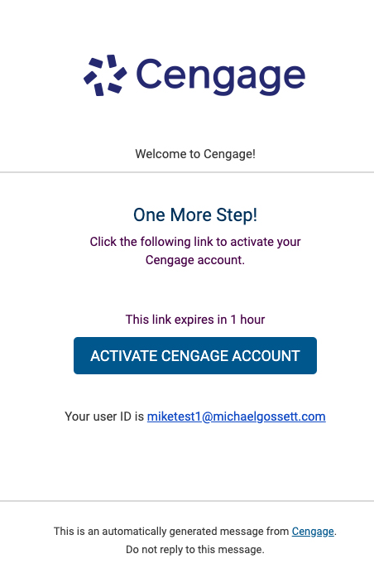
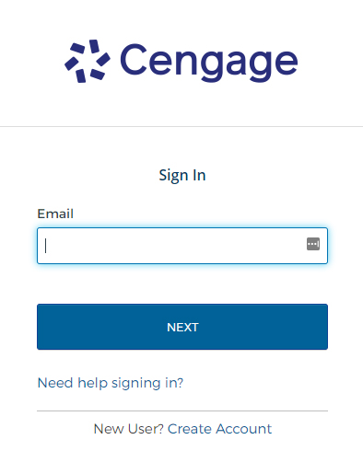
Log In To Your Account
Already have a
Cengage account? Log in.
New to Cengage?
Register now.
A
B
OR
Open the ‘Welcome to Cengage’ email that was sent to your email and click ‘Activate Cengage Account’ to set your password
You may already have a Cengage account if you’ve used MindTap, CengageNOWv2, SAM, WebAssign, another Cengage platform or Cengage eTextbook
in a different course.

Slide 4
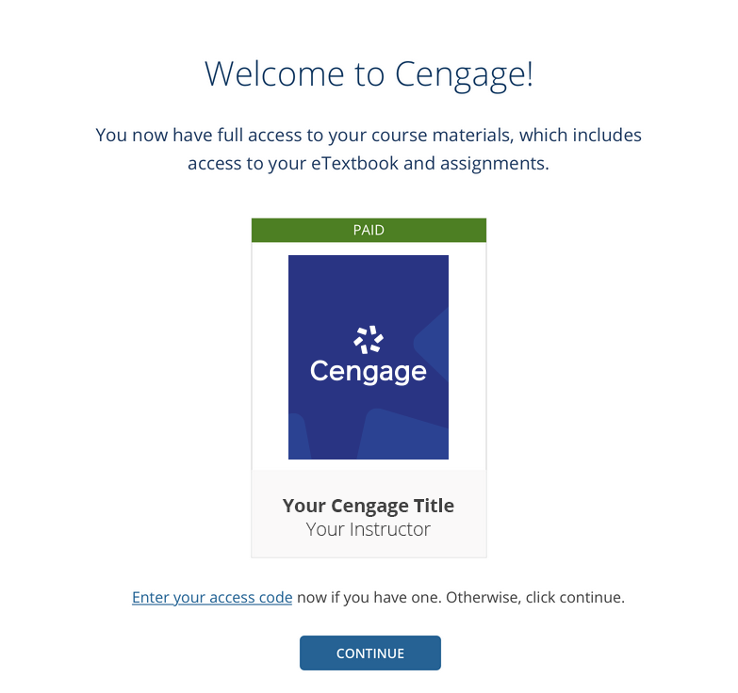
Enroll In Your Course
The Cengage materials for this course have already been purchased through the OU Inclusive Access program and you now have full access!
  This includes access to your eTextbook and assignments.
Click “Continue” to jump into your course.

Slide 5




Have Questions? We’re Here 24/7!
Find Us on
Social Media
@CengageHelp
Real-Time
System Status
Updates
Visit techcheck.cengage.com
to quickly see if
Cengage is experiencing technical difficulties.
Chat Support and
Online Self-Help
support.cengage.com
Give Us A Call
1-800-354-9706

